Slide 1

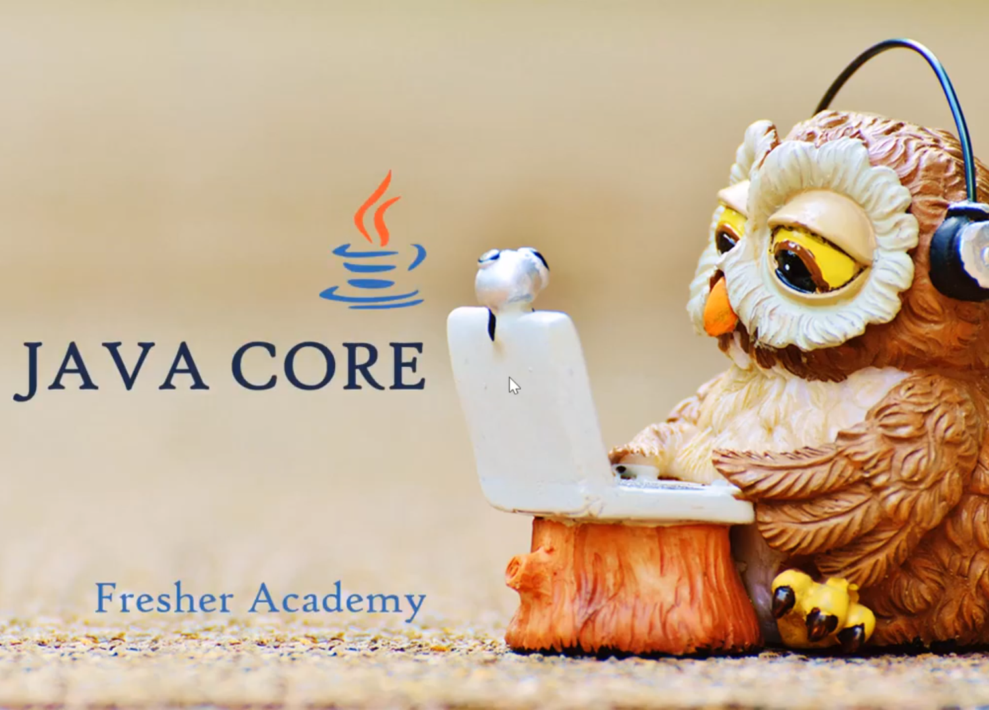

Slide 2

Course Structure
Sections
Threory
Labs
Quizzes
Final Test
Don’t Tell Me You Can’t

Slide 3

Once you stop learning, you start dying
Don’t Tell Me You Can’t

Slide 4
Java Introduction
History
Installation
IDEs
HelloWorld Program
JDK Commands
Don’t Tell Me You Can’t

Slide 5

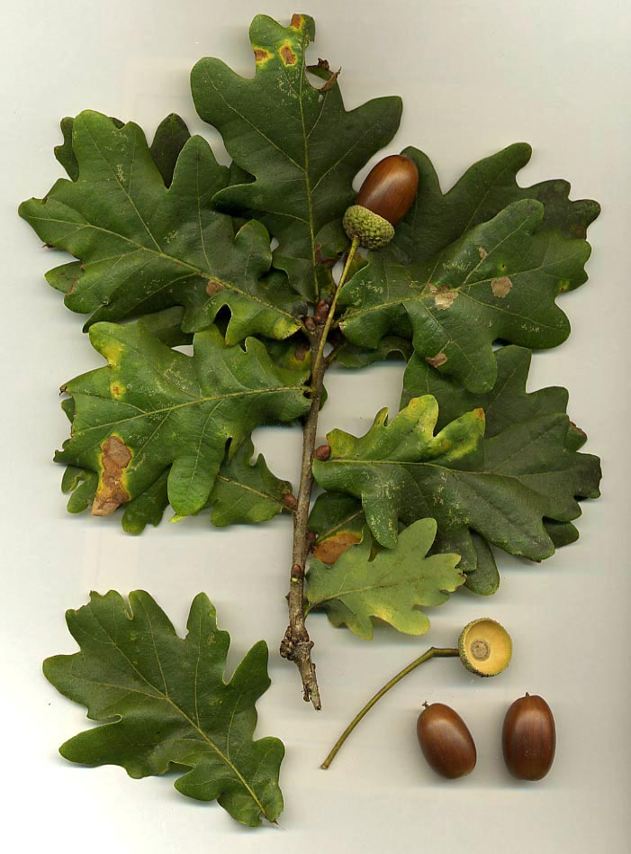


Java History
James Gosling
Oak
Java Coffee Indonesian
Don’t Tell Me You Can’t
Notes:
https://youtu.be/okF82kVI11Y?list=PL-gPfnsMEiqlj5To30Z7XVDJ0QRxVDNbV

Slide 6
Java History
JDK 1.0
(January 23, 1996)
J2SE 1.2
(December 8, 1998)
JJ2SEDK 1.4
(February 6, 2002)
Java SE 6
(December 11, 2006)
JDK 1.1
(February 19, 1997)
J2SE 1.3
(May 8, 2000)
J2SE 5.0
(September 30, 2004)
…
Don’t Tell Me You Can’t
Notes:
https://youtu.be/okF82kVI11Y?list=PL-gPfnsMEiqlj5To30Z7XVDJ0QRxVDNbV

Slide 7

Java Features
Don’t Tell Me You Can’t

Slide 8
Key Java Features
Java
Object Oriented
Platform Independent
Distributed
Multi-threads
Simple
Secured
Don’t Tell Me You Can’t
Notes:
https://youtu.be/vaLJgjNdV3M?list=PL-gPfnsMEiqlj5To30Z7XVDJ0QRxVDNbV

Slide 9
Java Installation
Don’t Tell Me You Can’t
Notes:
https://www.oracle.com/java/technologies/javase-downloads.html
https://youtu.be/OP5ovmSuDVA?list=PL-gPfnsMEiqlj5To30Z7XVDJ0QRxVDNbV

Slide 10
Write HelloWorld Program
Don’t Tell Me You Can’t
Notes:
https://youtu.be/vKVwwzbkkgA?list=PL-gPfnsMEiqlj5To30Z7XVDJ0QRxVDNbV

Slide 11
Run HelloWorld
Don’t Tell Me You Can’t
Notes:
https://youtu.be/vKVwwzbkkgA?list=PL-gPfnsMEiqlj5To30Z7XVDJ0QRxVDNbV

Slide 12
IDEs
Don’t Tell Me You Can’t
Notes:
https://youtu.be/vKVwwzbkkgA?list=PL-gPfnsMEiqlj5To30Z7XVDJ0QRxVDNbV

Slide 13
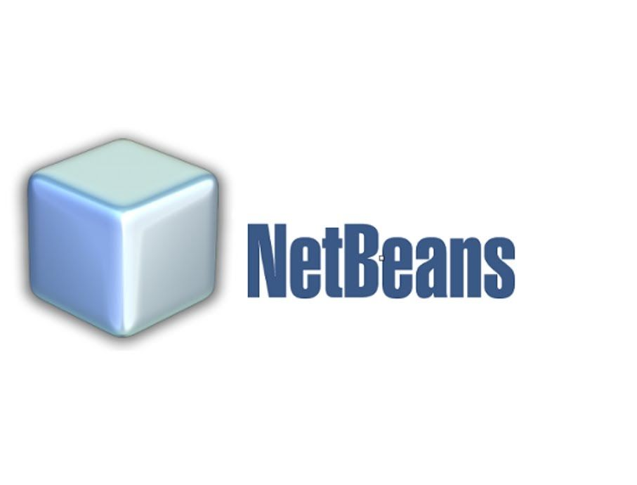


Java Integrated Development Environment
Don’t Tell Me You Can’t

Slide 14
HelloWorld in Eclipse
Don’t Tell Me You Can’t
Notes:
https://youtu.be/vKVwwzbkkgA?list=PL-gPfnsMEiqlj5To30Z7XVDJ0QRxVDNbV

Slide 15
Eclipse
Don’t Tell Me You Can’t
Notes:
https://youtu.be/vKVwwzbkkgA?list=PL-gPfnsMEiqlj5To30Z7XVDJ0QRxVDNbV

Slide 16
Working Set
Don’t Tell Me You Can’t
Notes:
https://youtu.be/GRthYH2cJc4?list=PL-gPfnsMEiqlj5To30Z7XVDJ0QRxVDNbV

Slide 17
Class Header
Don’t Tell Me You Can’t
Notes:
https://youtu.be/km6XgVY8ewE?list=PL-gPfnsMEiqlj5To30Z7XVDJ0QRxVDNbV

Slide 18
The main() method
Don’t Tell Me You Can’t
Notes:
https://youtu.be/km6XgVY8ewE?list=PL-gPfnsMEiqlj5To30Z7XVDJ0QRxVDNbV

Slide 19
The main() method
public static void main(String[] args) {
}
It is the starting point and required for any Java program
It must be public and static
There is not return type (void)
String[] args are arguments for the program
Don’t Tell Me You Can’t
Notes:
https://youtu.be/0GeFYIkEO-g?list=PL-gPfnsMEiqlj5To30Z7XVDJ0QRxVDNbV

Slide 20
Comments
Don’t Tell Me You Can’t
Notes:
https://youtu.be/km6XgVY8ewE?list=PL-gPfnsMEiqlj5To30Z7XVDJ0QRxVDNbV

Slide 21
JAR – Java Archive
Runnable Java File
Don’t Tell Me You Can’t
Notes:
https://youtu.be/CMzqrDj5Z2Q?list=PL-gPfnsMEiqlj5To30Z7XVDJ0QRxVDNbV

Slide 22
Java Archive
jar command
Why do we need jar files?
Using Eclipse
Java build tools
Don’t Tell Me You Can’t
Notes:
https://www.youtube.com/watch?v=7va0v0FxuA0&list=PL-gPfnsMEiqlj5To30Z7XVDJ0QRxVDNbV&index=17

Slide 23
jar command
Don’t Tell Me You Can’t
Notes:
https://youtu.be/YSZFA4PFLAU?list=PL-gPfnsMEiqlj5To30Z7XVDJ0QRxVDNbV

Slide 24
jar command
Don’t Tell Me You Can’t
Notes:
https://youtu.be/km6XgVY8ewE?list=PL-gPfnsMEiqlj5To30Z7XVDJ0QRxVDNbV

Slide 25
Run jar files
Don’t Tell Me You Can’t
Notes:
https://youtu.be/km6XgVY8ewE?list=PL-gPfnsMEiqlj5To30Z7XVDJ0QRxVDNbV

Slide 26
Why do we need jar files ?
Don’t Tell Me You Can’t
Notes:
https://youtu.be/km6XgVY8ewE?list=PL-gPfnsMEiqlj5To30Z7XVDJ0QRxVDNbV

Slide 27
Java Archive
JAR is a zip format including .class files
Used in Runtime without compiling files
Used as executable and runnable files
Used as libraries (Security, extendable, flexible)
Don’t Tell Me You Can’t
Notes:
https://www.youtube.com/watch?v=7va0v0FxuA0&list=PL-gPfnsMEiqlj5To30Z7XVDJ0QRxVDNbV&index=17

Slide 28
Create jar files using Eclipse
Don’t Tell Me You Can’t
Notes:
https://youtu.be/entla_iMBz0?list=PL-gPfnsMEiqlj5To30Z7XVDJ0QRxVDNbV

Slide 29



Java build tool overview
Don’t Tell Me You Can’t
Notes:
https://youtu.be/entla_iMBz0?list=PL-gPfnsMEiqlj5To30Z7XVDJ0QRxVDNbV

Slide 30
Java Archive
<plugin>
<groupId>org.apache.maven.plugin</groupId>
<artifactId>maven-jar-plugin</artifactId>
<configuration>
<excludes>
<excludes>**/log4j.properties</excludes>
</excludes>
</configuration>
<archive>
<manifest>
<mainClass>fa.FresherAcademy</mainClass>
</manifest>
</archive>
</plugin>
Don’t Tell Me You Can’t
Notes:
https://www.youtube.com/watch?v=7va0v0FxuA0&list=PL-gPfnsMEiqlj5To30Z7XVDJ0QRxVDNbV&index=17

Slide 31
Java Archive
apply plugin: ’java’
apply plugin: ‘eclipse’
version = ‘1.0’
sourceCompatibility = 1.8
targetCompatibility = 1.8
task fatJav(type: Jar) {
manifest {
attributes ‘Implementation-Title’: ‘Gradle Jar File Example’,
‘Implementation-Version’: version,
‘Main-Class’: ‘fa.FresherAcademy’
}
baseName = project.name + ‘-all’
from { configuration.compile.collect { it.is.Directory() ? It :zipTree(it)} }
with jar
}
Don’t Tell Me You Can’t
Notes:
https://www.youtube.com/watch?v=7va0v0FxuA0&list=PL-gPfnsMEiqlj5To30Z7XVDJ0QRxVDNbV&index=17

Slide 32
Java Archive
<target name=“compile” depends=“init”>
<javac srcdir=“src” destdir=“build/classed”/>
</target>
<target name=“compress” depends=“compile”>
<jar destfile=“dist/FresherAcademy.jar” basedir=“build/classes”>
<manifest>
<attribute name=“Main-Class” value=“fa.FresherAcademy”/>
</manifest>
</jar>
</target>
Don’t Tell Me You Can’t
Notes:
https://www.youtube.com/watch?v=7va0v0FxuA0&list=PL-gPfnsMEiqlj5To30Z7XVDJ0QRxVDNbV&index=17

Slide 33
Basic Oriented Object Programming
Don’t Tell Me You Can’t
Notes:
https://youtu.be/entla_iMBz0?list=PL-gPfnsMEiqlj5To30Z7XVDJ0QRxVDNbV

Slide 34
Basic OOP
Class
Interface
Access Modifiers
Package
OOP Characteristics
Don’t Tell Me You Can’t
Notes:
https://www.youtube.com/watch?v=7va0v0FxuA0&list=PL-gPfnsMEiqlj5To30Z7XVDJ0QRxVDNbV&index=17

Slide 35
Class Denfinition
Don’t Tell Me You Can’t
Notes:
https://youtu.be/entla_iMBz0?list=PL-gPfnsMEiqlj5To30Z7XVDJ0QRxVDNbV

Slide 36
A class is a declaration to generate Java object
Don’t Tell Me You Can’t
Notes:
https://youtu.be/entla_iMBz0?list=PL-gPfnsMEiqlj5To30Z7XVDJ0QRxVDNbV

Slide 37
A class, in Java, is where we teach object how to behave
Don’t Tell Me You Can’t
Notes:
https://youtu.be/entla_iMBz0?list=PL-gPfnsMEiqlj5To30Z7XVDJ0QRxVDNbV

Slide 38
Java Class
Access_Modifier class Class_Name{
class body: attributes vs methods
}
package fa;
public class FresherAcademy {
private String message = “ Hello Fresher Academy”;
public void showMessage(){
System.out.println(message);
}
}
Don’t Tell Me You Can’t
Notes:
https://www.youtube.com/watch?v=7va0v0FxuA0&list=PL-gPfnsMEiqlj5To30Z7XVDJ0QRxVDNbV&index=17

Slide 39
public class & Java file
Don’t Tell Me You Can’t
Notes:
https://youtu.be/entla_iMBz0?list=PL-gPfnsMEiqlj5To30Z7XVDJ0QRxVDNbV

Slide 40
Java Class
One or zero public class inside a Java file
The public class (if any) name must be the same the Java file name
If the is no public class, the Java file name could be anything (legal naming)
If we want to run the main method from a method from a class, it must be public
Don’t Tell Me You Can’t
Notes:
https://youtu.be/J9We5VKTrUU?list=PL-gPfnsMEiqlj5To30Z7XVDJ0QRxVDNbV

Slide 41
public class & Java file Lab
Don’t Tell Me You Can’t
Notes:
https://youtu.be/ieioCwpMMzo?list=PL-gPfnsMEiqlj5To30Z7XVDJ0QRxVDNbV

Slide 42
Packages
Don’t Tell Me You Can’t
Notes:
https://youtu.be/3TH3m7VN34M?list=PL-gPfnsMEiqlj5To30Z7XVDJ0QRxVDNbV

Slide 43
A package is a namespace
That organizes a set of related classes and interfaces
Don’t Tell Me You Can’t
Notes:
https://youtu.be/3TH3m7VN34M?list=PL-gPfnsMEiqlj5To30Z7XVDJ0QRxVDNbV

Slide 44
Conceptually you can think of packages as being similar to different folders on your computer.
Don’t Tell Me You Can’t
Notes:
https://youtu.be/3TH3m7VN34M?list=PL-gPfnsMEiqlj5To30Z7XVDJ0QRxVDNbV

Slide 45
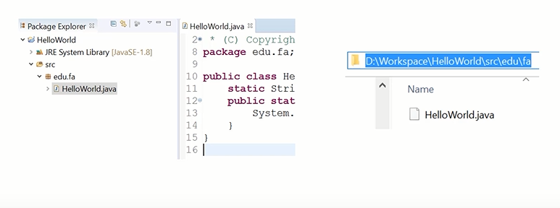
Java Package Samples
Don’t Tell Me You Can’t
Notes:
https://youtu.be/J9We5VKTrUU?list=PL-gPfnsMEiqlj5To30Z7XVDJ0QRxVDNbV

Slide 46

Access modifiers
Don’t Tell Me You Can’t
Notes:
https://youtu.be/3TH3m7VN34M?list=PL-gPfnsMEiqlj5To30Z7XVDJ0QRxVDNbV

Slide 47
The access modifiers define
The scope of variables, methods, constructors or classes.
Don’t Tell Me You Can’t
Notes:
https://youtu.be/3TH3m7VN34M?list=PL-gPfnsMEiqlj5To30Z7XVDJ0QRxVDNbV

Slide 48
Access Modifiers
Visibility | Public | Protected | Default | Private
From the same class | Yes | Yes | Yes | Yes
From any class in the same package | Yes | Yes | Yes | No
From a subclass in the same package | Yes | Yes | Yes | No
From a subclass outside the same package | Yes | Yes, through inheritance | No | No
From any non-subclass class outside the package | Yes | No | No | No
Public: Visible to the world
Protected: Visible to the package and all subclass
Default: Visible to the package. No modifiers are needed.
Private: Visible to the class only.
Don’t Tell Me You Can’t
Notes:
https://youtu.be/J9We5VKTrUU?list=PL-gPfnsMEiqlj5To30Z7XVDJ0QRxVDNbV

Slide 49
Class attributes
Don’t Tell Me You Can’t
Notes:
https://youtu.be/3TH3m7VN34M?list=PL-gPfnsMEiqlj5To30Z7XVDJ0QRxVDNbV

Slide 50
Attributes – Class Variables – Instance Variables
Data Members - Properties
Don’t Tell Me You Can’t
Notes:
https://youtu.be/3TH3m7VN34M?list=PL-gPfnsMEiqlj5To30Z7XVDJ0QRxVDNbV

Slide 51
Modifiers Type attribute_name [ = Init Value ]
Don’t Tell Me You Can’t
Notes:
https://youtu.be/3TH3m7VN34M?list=PL-gPfnsMEiqlj5To30Z7XVDJ0QRxVDNbV

Slide 52
Access Modifiers
Data Type | Default Values
byte | 0
short | 0
int | 0
long | 0
float | 0
double | 0
char | U0000
boolean | false
String (or any object ) | null
Don’t Tell Me You Can’t
Notes:
https://youtu.be/J9We5VKTrUU?list=PL-gPfnsMEiqlj5To30Z7XVDJ0QRxVDNbV

Slide 53
Class methods
Don’t Tell Me You Can’t
Notes:
https://youtu.be/3TH3m7VN34M?list=PL-gPfnsMEiqlj5To30Z7XVDJ0QRxVDNbV

Slide 54
A java method is a collection of statements
That are grouped together to perform an operation.
Don’t Tell Me You Can’t
Notes:
https://youtu.be/3TH3m7VN34M?list=PL-gPfnsMEiqlj5To30Z7XVDJ0QRxVDNbV

Slide 55
Java Method Declaration
Modifiers Return_Type Method_Name([Parameters]) [throws Exception_List] {
//Body
}
Modifiers (Optional)
Return_Type (Required): a data type or void
Method_Name (Required): used to call somewhere
() (Required) and Parameters (Optional)
Exception_List (Optional)
{ Body } (Required for non-abstract method)
Don’t Tell Me You Can’t
Notes:
https://youtu.be/J9We5VKTrUU?list=PL-gPfnsMEiqlj5To30Z7XVDJ0QRxVDNbV

Slide 56
Class Lab
Don’t Tell Me You Can’t
Notes:
https://youtu.be/yuxsi_oUF7U?list=PL-gPfnsMEiqlj5To30Z7XVDJ0QRxVDNbV

Slide 57
Abstract Method
Don’t Tell Me You Can’t
Notes:
https://youtu.be/yuxsi_oUF7U?list=PL-gPfnsMEiqlj5To30Z7XVDJ0QRxVDNbV

Slide 58
public abstract void study();
Don’t Tell Me You Can’t
Notes:
https://youtu.be/yuxsi_oUF7U?list=PL-gPfnsMEiqlj5To30Z7XVDJ0QRxVDNbV

Slide 59
Constructors
Don’t Tell Me You Can’t
Notes:
https://youtu.be/yuxsi_oUF7U?list=PL-gPfnsMEiqlj5To30Z7XVDJ0QRxVDNbV

Slide 60
Constructor in java is a special type of method
That is used to initialize the object.
Don’t Tell Me You Can’t
Notes:
https://youtu.be/yuxsi_oUF7U?list=PL-gPfnsMEiqlj5To30Z7XVDJ0QRxVDNbV

Slide 61
The constructor has the same name with the class
Don’t Tell Me You Can’t
Notes:
https://youtu.be/yuxsi_oUF7U?list=PL-gPfnsMEiqlj5To30Z7XVDJ0QRxVDNbV

Slide 62
There is no return type (even void)
Don’t Tell Me You Can’t
Notes:
https://youtu.be/yuxsi_oUF7U?list=PL-gPfnsMEiqlj5To30Z7XVDJ0QRxVDNbV

Slide 63
Every class has a constructor.
Don’t Tell Me You Can’t
Notes:
https://youtu.be/yuxsi_oUF7U?list=PL-gPfnsMEiqlj5To30Z7XVDJ0QRxVDNbV

Slide 64
Constructors could have parameters or not
Don’t Tell Me You Can’t
Notes:
https://youtu.be/yuxsi_oUF7U?list=PL-gPfnsMEiqlj5To30Z7XVDJ0QRxVDNbV

Slide 65
Use new keyword to initialize an object
(automatic call a constructor)
Don’t Tell Me You Can’t
Notes:
https://youtu.be/yuxsi_oUF7U?list=PL-gPfnsMEiqlj5To30Z7XVDJ0QRxVDNbV

Slide 66
Default Constructor
Don’t Tell Me You Can’t
Notes:
https://youtu.be/yuxsi_oUF7U?list=PL-gPfnsMEiqlj5To30Z7XVDJ0QRxVDNbV

Slide 67
By default,
Every class has a public constructor with no parameter
Don’t Tell Me You Can’t
Notes:
https://youtu.be/yuxsi_oUF7U?list=PL-gPfnsMEiqlj5To30Z7XVDJ0QRxVDNbV

Slide 68
If you declare a constructor
Java will remove the default constructor.
Don’t Tell Me You Can’t
Notes:
https://youtu.be/yuxsi_oUF7U?list=PL-gPfnsMEiqlj5To30Z7XVDJ0QRxVDNbV

Slide 69
Constructor Labs
Don’t Tell Me You Can’t
Notes:
https://youtu.be/HsdT2Bn3PDo?list=PL-gPfnsMEiqlj5To30Z7XVDJ0QRxVDNbV

Slide 70
Getters and Setters
Don’t Tell Me You Can’t
Notes:
https://youtu.be/HsdT2Bn3PDo?list=PL-gPfnsMEiqlj5To30Z7XVDJ0QRxVDNbV

Slide 71
Always set attributes as private
Don’t Tell Me You Can’t
Notes:
https://youtu.be/rDPgYeAIBfE?list=PL-gPfnsMEiqlj5To30Z7XVDJ0QRxVDNbV

Slide 72
Setters
Use to set values for attributes
It must be public void
Public void setAttributeName(Attribute_Data_Type new Value(){
this.attributeName = new Value;
}
Don’t Tell Me You Can’t
Notes:
https://youtu.be/J9We5VKTrUU?list=PL-gPfnsMEiqlj5To30Z7XVDJ0QRxVDNbV

Slide 73
Getters
Use to get attribute values
It must be public and no parameter
Public Attribute_Data_Type getAttributeName(){
return this.attributeName;
}
Don’t Tell Me You Can’t
Notes:
https://youtu.be/J9We5VKTrUU?list=PL-gPfnsMEiqlj5To30Z7XVDJ0QRxVDNbV

Slide 74
Getters and Setters Lab
Don’t Tell Me You Can’t
Notes:
https://youtu.be/UH8rLPWrOF8?list=PL-gPfnsMEiqlj5To30Z7XVDJ0QRxVDNbV

Slide 75
Generate Getters and Setters
Alt + Shift + S -> R -> select options we wants to generate
Or
Click Right Mouse -> Source -> Generate Getters and Setters -> ….
Don’t Tell Me You Can’t
Notes:
https://youtu.be/J9We5VKTrUU?list=PL-gPfnsMEiqlj5To30Z7XVDJ0QRxVDNbV

Slide 76
Interface Definition
Don’t Tell Me You Can’t
Notes:
https://youtu.be/UH8rLPWrOF8?list=PL-gPfnsMEiqlj5To30Z7XVDJ0QRxVDNbV

Slide 77
An interface is a reference type in Java. It is similar to class.
It is a collection of abstract methods.
Don’t Tell Me You Can’t
Notes:
https://youtu.be/UH8rLPWrOF8?list=PL-gPfnsMEiqlj5To30Z7XVDJ0QRxVDNbV

Slide 78
Java Interface
Access_Modifier interface Interface_Name{
// interface body:attributes vs methods
}
Package fa;
Public interface FresherAcademy{
public static final String NAME = “Fresher Academy”
public abstract void shareContent();
}
Don’t Tell Me You Can’t
Notes:
https://youtu.be/J9We5VKTrUU?list=PL-gPfnsMEiqlj5To30Z7XVDJ0QRxVDNbV

Slide 79
Interface attributes
Don’t Tell Me You Can’t
Notes:
https://youtu.be/UH8rLPWrOF8?list=PL-gPfnsMEiqlj5To30Z7XVDJ0QRxVDNbV

Slide 80
public static final Data_Type ATTR_NAME = Value;
Don’t Tell Me You Can’t
Notes:
https://youtu.be/UH8rLPWrOF8?list=PL-gPfnsMEiqlj5To30Z7XVDJ0QRxVDNbV

Slide 81
Interface methods
Don’t Tell Me You Can’t
Notes:
https://youtu.be/UH8rLPWrOF8?list=PL-gPfnsMEiqlj5To30Z7XVDJ0QRxVDNbV

Slide 82
public abstract Return_Type Method_Name([params]);
Don’t Tell Me You Can’t
Notes:
https://youtu.be/z4I9ozcaeuI?list=PL-gPfnsMEiqlj5To30Z7XVDJ0QRxVDNbV

Slide 83
Interface Lab
Don’t Tell Me You Can’t
Notes:
https://youtu.be/-i8tnwlkz3s?list=PL-gPfnsMEiqlj5To30Z7XVDJ0QRxVDNbV
Abstract method() kết thúc bằng dấu chấm phẩy ( ; ), và không có thân hàm

Slide 84
Abstract Class
Don’t Tell Me You Can’t
Notes:
https://youtu.be/-i8tnwlkz3s?list=PL-gPfnsMEiqlj5To30Z7XVDJ0QRxVDNbV
Abstract method() kết thúc bằng dấu chấm phẩy ( ; ), và không có thân hàm

Slide 85
A class that is declared with abstract keyword.
Don’t Tell Me You Can’t
Notes:
https://youtu.be/6oSFuD9za80?list=PL-gPfnsMEiqlj5To30Z7XVDJ0QRxVDNbV

Slide 86
Java Interface
Abstract classes may or may not contain abstract methods.
If a class has at least one abstract method, then the class must be declared abstract.
If a class is declared abstract, it cannot be instantiated.
public abstract class FresherAcademy{
String message;
public abstract void study();
public void showMessage(){
System.out.println(message);
}
}
Don’t Tell Me You Can’t
Notes:
https://youtu.be/J9We5VKTrUU?list=PL-gPfnsMEiqlj5To30Z7XVDJ0QRxVDNbV

Slide 87
Abstract Class Lab
Don’t Tell Me You Can’t
Notes:
https://youtu.be/-i8tnwlkz3s?list=PL-gPfnsMEiqlj5To30Z7XVDJ0QRxVDNbV
Abstract method() kết thúc bằng dấu chấm phẩy ( ; ), và không có thân hàm

Slide 88
Inheritance
Don’t Tell Me You Can’t
Notes:
https://youtu.be/-i8tnwlkz3s?list=PL-gPfnsMEiqlj5To30Z7XVDJ0QRxVDNbV
Abstract method() kết thúc bằng dấu chấm phẩy ( ; ), và không có thân hàm

Slide 89
How to reuse class resources (variables and methods)
Don’t Tell Me You Can’t
Notes:
https://youtu.be/-i8tnwlkz3s?list=PL-gPfnsMEiqlj5To30Z7XVDJ0QRxVDNbV
Abstract method() kết thúc bằng dấu chấm phẩy ( ; ), và không có thân hàm

Slide 90
Java Interface
Use two keywords: extends and implements
Inherited resources depends on the access modifiers
By default, every class is inherited default constructor
All Java classes inherit the Object class
Super class/sub class; parent class. Child class
A class extends an abstract class or implements an interface, it must override all abstract methods and implement the body
Class
Interface
Interface
extends
implements
extends
Class
Don’t Tell Me You Can’t
interface
Class
Notes:
https://youtu.be/J9We5VKTrUU?list=PL-gPfnsMEiqlj5To30Z7XVDJ0QRxVDNbV

Slide 91
Inheritance increases the Reusability
Don’t Tell Me You Can’t
Notes:
https://youtu.be/-i8tnwlkz3s?list=PL-gPfnsMEiqlj5To30Z7XVDJ0QRxVDNbV
Abstract method() kết thúc bằng dấu chấm phẩy ( ; ), và không có thân hàm

Slide 92
Inheritance lab
Don’t Tell Me You Can’t
Notes:
https://youtu.be/6KgLdn9S8eE?list=PL-gPfnsMEiqlj5To30Z7XVDJ0QRxVDNbV

Slide 93
Abstraction
Don’t Tell Me You Can’t
Notes:
https://youtu.be/6KgLdn9S8eE?list=PL-gPfnsMEiqlj5To30Z7XVDJ0QRxVDNbV

Slide 94
Java Abstraction
Abstraction is a process of hiding the implementation details from the user, only the functionality will be provided to the user.
Achieved by using abstract classes or interfaces.
All subclass must implement abstract methods from abstract cases or interface
However, the method signature or APIs are the same.
Abstraction hides the details of objects, the detailed of implementation, the details of how to operate.
The users just care about the APIs, the results or the outputs
Class
Interface
Interface
extends
implements
extends
Class
Don’t Tell Me You Can’t
interface
Class
Notes:
https://youtu.be/J9We5VKTrUU?list=PL-gPfnsMEiqlj5To30Z7XVDJ0QRxVDNbV

Slide 95
Abstraction increases the Extendability
Don’t Tell Me You Can’t
Notes:
https://youtu.be/6KgLdn9S8eE?list=PL-gPfnsMEiqlj5To30Z7XVDJ0QRxVDNbV

Slide 96
Abstraction Lab
Don’t Tell Me You Can’t
Notes:
https://youtu.be/6KgLdn9S8eE?list=PL-gPfnsMEiqlj5To30Z7XVDJ0QRxVDNbV

Slide 97
Encapsulation
Don’t Tell Me You Can’t
Notes:
https://youtu.be/6KgLdn9S8eE?list=PL-gPfnsMEiqlj5To30Z7XVDJ0QRxVDNbV

Slide 98
How to hide data
Don’t Tell Me You Can’t
Notes:
https://youtu.be/6KgLdn9S8eE?list=PL-gPfnsMEiqlj5To30Z7XVDJ0QRxVDNbV

Slide 99
Java Abstraction
Declare attributes as private
Generate setters and getters to set and get attribute values
Other classes cannot access directly the attributes of a class.
The only way is through methods like getters and setters
Known as data hiding
Group classes and interfaces into packages
Don’t Tell Me You Can’t
Notes:
https://youtu.be/J9We5VKTrUU?list=PL-gPfnsMEiqlj5To30Z7XVDJ0QRxVDNbV

Slide 100
Encapsulation increases the Security
Don’t Tell Me You Can’t
Notes:
https://youtu.be/6KgLdn9S8eE?list=PL-gPfnsMEiqlj5To30Z7XVDJ0QRxVDNbV

Slide 101
Encapsulation Lab
Don’t Tell Me You Can’t
Notes:
https://youtu.be/vhHE1Jk46BY?list=PL-gPfnsMEiqlj5To30Z7XVDJ0QRxVDNbV

Slide 102
Polymorphism
Don’t Tell Me You Can’t
Notes:
https://youtu.be/vhHE1Jk46BY?list=PL-gPfnsMEiqlj5To30Z7XVDJ0QRxVDNbV

Slide 103
One Name, Many Forms
Don’t Tell Me You Can’t
Notes:
https://youtu.be/vhHE1Jk46BY?list=PL-gPfnsMEiqlj5To30Z7XVDJ0QRxVDNbV

Slide 104
Java Abstraction
Overriding and Overloading allow flexible using methods with the same name
An object of a subclass could be assigned to a reference of the super class
SuperClass myObject = new SubClass();
Runtime Polymorphism: an overridden method is called through the reference variable of a superclass
Anonymous class is another example of polymorphism
Don’t Tell Me You Can’t
Notes:
https://youtu.be/J9We5VKTrUU?list=PL-gPfnsMEiqlj5To30Z7XVDJ0QRxVDNbV

Slide 105
Polymorphism increases the Flexibility
Don’t Tell Me You Can’t
Notes:
https://youtu.be/vhHE1Jk46BY?list=PL-gPfnsMEiqlj5To30Z7XVDJ0QRxVDNbV

Slide 106
Java OOP
Don’t Tell Me You Can’t
Notes:
https://youtu.be/vhHE1Jk46BY?list=PL-gPfnsMEiqlj5To30Z7XVDJ0QRxVDNbV

Slide 107
Abstraction vs Encapsulation
Don’t Tell Me You Can’t
Notes:
https://youtu.be/vhHE1Jk46BY?list=PL-gPfnsMEiqlj5To30Z7XVDJ0QRxVDNbV

Slide 108
Abstraction – Hide details of implementation
Encapsulation – Hide data
Don’t Tell Me You Can’t
Notes:
https://youtu.be/vhHE1Jk46BY?list=PL-gPfnsMEiqlj5To30Z7XVDJ0QRxVDNbV

Slide 109
Use Inheritance to Build Abstraction and Allow Polymorphism
Don’t Tell Me You Can’t
Notes:
https://youtu.be/vhHE1Jk46BY?list=PL-gPfnsMEiqlj5To30Z7XVDJ0QRxVDNbV

Slide 110
Summary
Don’t Tell Me You Can’t
Notes:
https://youtu.be/vhHE1Jk46BY?list=PL-gPfnsMEiqlj5To30Z7XVDJ0QRxVDNbV

Slide 111
Basic OOP
Class
Interface
Access Modifiers
Package
OOP Characteristics
Don’t Tell Me You Can’t
Notes:
https://www.youtube.com/watch?v=7va0v0FxuA0&list=PL-gPfnsMEiqlj5To30Z7XVDJ0QRxVDNbV&index=17

Slide 112
Declaration vs Assignment
Don’t Tell Me You Can’t
Notes:
https://youtu.be/vhHE1Jk46BY?list=PL-gPfnsMEiqlj5To30Z7XVDJ0QRxVDNbV

Slide 113
Basic OOP
Identifiers
Java Naming Convention
Variables
Primitive Data
Garbage Collection
Autoboxing
Don’t Tell Me You Can’t
Notes:
https://youtu.be/rHi3i4Ee9ic?list=PL-gPfnsMEiqlj5To30Z7XVDJ0QRxVDNbV

Slide 114
Java Identifiers
Don’t Tell Me You Can’t
Notes:
https://youtu.be/vhHE1Jk46BY?list=PL-gPfnsMEiqlj5To30Z7XVDJ0QRxVDNbV

Slide 115
Variables, Methods, Class Names
Don’t Tell Me You Can’t
Notes:
https://youtu.be/vhHE1Jk46BY?list=PL-gPfnsMEiqlj5To30Z7XVDJ0QRxVDNbV

Slide 116
Java Abstraction
Identifiers are case-sensitive.
Names could include letters, digits, dollar signs, or underscore characters.
Names could start with a letter, dollar signs or underscore
Name could not start with a digit
Don’t Tell Me You Can’t
Notes:
https://youtu.be/J9We5VKTrUU?list=PL-gPfnsMEiqlj5To30Z7XVDJ0QRxVDNbV

Slide 117
Java Identifier Lab
Don’t Tell Me You Can’t
Notes:
https://youtu.be/vhHE1Jk46BY?list=PL-gPfnsMEiqlj5To30Z7XVDJ0QRxVDNbV

Slide 118
Java Keywords
Don’t Tell Me You Can’t
Notes:
https://youtu.be/vhHE1Jk46BY?list=PL-gPfnsMEiqlj5To30Z7XVDJ0QRxVDNbV

Slide 119
Java Abstraction
abstract | continue | for | new | switch
asset*** | default | goto* | package | synchronized
boolean | do | if | private | this
break | double | implements | protected | throw
byte | else | import | public | throws
case | enum**** | instanceof | return | transient
catch | extends | int | short | try
char | final | interface | static | void
class | finally | long | strictfp** | volatile
const* | float | native | super | While
* | not used
** | added in 1.2
*** | added in 1.4
Don’t Tell Me You Can’t
Notes:
https://youtu.be/J9We5VKTrUU?list=PL-gPfnsMEiqlj5To30Z7XVDJ0QRxVDNbV

Slide 120
Cannot use keywords as identifiers in Java programs
Don’t Tell Me You Can’t
Notes:
https://youtu.be/vhHE1Jk46BY?list=PL-gPfnsMEiqlj5To30Z7XVDJ0QRxVDNbV

Slide 121
Java Keywords Lab
Don’t Tell Me You Can’t
Notes:
https://youtu.be/vwmUeHcn6H0?list=PL-gPfnsMEiqlj5To30Z7XVDJ0QRxVDNbV

Slide 122
Java Naming Convention
Don’t Tell Me You Can’t
Notes:
https://youtu.be/vwmUeHcn6H0?list=PL-gPfnsMEiqlj5To30Z7XVDJ0QRxVDNbV

Slide 123
Java Abstraction
Package:
Lower case nouns, separated by.
It should be narrow down
Class vs Interface
It should be nouns or noun phrases
Upper case the first letter
Method
It should be a verb or verb phrase
Lower case the first word
Upper case the first letter of next words
Variable:
It should be nouns or noun phrases
Lower case the first word
Upper case the first letter of next words
Constant
It should be upper case
Words separated by underscores
Don’t Tell Me You Can’t
Notes:
https://youtu.be/J9We5VKTrUU?list=PL-gPfnsMEiqlj5To30Z7XVDJ0QRxVDNbV

Slide 124
Java Naming Convention Lab
Don’t Tell Me You Can’t
Notes:
https://youtu.be/vwmUeHcn6H0?list=PL-gPfnsMEiqlj5To30Z7XVDJ0QRxVDNbV

Slide 125
mypackage
(Lower Case)
Don’t Tell Me You Can’t
Notes:
https://youtu.be/vwmUeHcn6H0?list=PL-gPfnsMEiqlj5To30Z7XVDJ0QRxVDNbV

Slide 126
MYPACKAGE
(Upper Case)
Don’t Tell Me You Can’t
Notes:
https://youtu.be/vwmUeHcn6H0?list=PL-gPfnsMEiqlj5To30Z7XVDJ0QRxVDNbV

Slide 127
MyPackage
(Camel Case)
Don’t Tell Me You Can’t
Notes:
https://youtu.be/vwmUeHcn6H0?list=PL-gPfnsMEiqlj5To30Z7XVDJ0QRxVDNbV

Slide 128
myPackage
(Mixed Case ~ Lower Camel Case)
Don’t Tell Me You Can’t
Notes:
https://youtu.be/pDH5hWxj6z0?list=PL-gPfnsMEiqlj5To30Z7XVDJ0QRxVDNbV

Slide 129
Global variables
Don’t Tell Me You Can’t
Notes:
https://youtu.be/vwmUeHcn6H0?list=PL-gPfnsMEiqlj5To30Z7XVDJ0QRxVDNbV

Slide 130
They are class attributes
Don’t Tell Me You Can’t
Notes:
https://youtu.be/vwmUeHcn6H0?list=PL-gPfnsMEiqlj5To30Z7XVDJ0QRxVDNbV

Slide 131
Global Variables have default values
Don’t Tell Me You Can’t
Notes:
https://youtu.be/vwmUeHcn6H0?list=PL-gPfnsMEiqlj5To30Z7XVDJ0QRxVDNbV

Slide 132
Class attributes – Global variables lab
Don’t Tell Me You Can’t
Notes:
https://youtu.be/vwmUeHcn6H0?list=PL-gPfnsMEiqlj5To30Z7XVDJ0QRxVDNbV

